Slide 1

VIGNAN’S NIRULA INSTITUTE OF TECHNOLOGY AND SCIENCE FOR WOMEN
DEPARTMENT OF CSE
PREDICTION OF DISSOLVED OXYGEN IN AQUACULTURE PONDS USING LSTM-GRU(HYBRID) MODEL
Under the Esteemed Guidance of
Mr. A.Peda Gopi
Assistant professor
Presented By:
Batch 02
S.Lavanya (20NN1A05A4)
R.Hema Latha (20NN1A0598)
R.Srivani (20NN1A05A1)
R.Rajya Lakshmi (20NN1A0599)

Slide 2
CONTENTS
Abstract
Introduction
Literature Survey
Existing System
Drawbacks of Existing System
Proposed System
Proposed Algorithm
System Design
UML Diagrams
Conclusion
References

Slide 3
ABSTRACT
The presence of dissolved oxygen (DO) in water is an ecological factor that plays an important role in fostering the growth of aquatic goods. The amount of DO in recirculating aquaculture systems is a critical indicator of control. Its composition and the dynamic fluctuations have a substantial impact on the rohu fish capacity to grow in a healthy manner. The amount of dissolved oxygen in water is determined by several biological, physical and chemical features, including PH, BOD; EC, Temperature; Ca; Mg, Nitrate; Turbidity; PO4, Na and NO3 respectively. Because of this, it is essential to conduct dissolved oxygen tests on water. In former times, individuals predicted the water quality using conventional methods such as laboratory examination. Traditional approaches, on the other hand, are unable to collect non-linear and non-stationary data regarding water quality. In addition, laboratory methods demand a significant amount of both time and physical labour. In the fields of ML, DL and artificial neural networks (ANN), long shortterm memory (LSTM), and gated recurrent units (GRU) are utilised quite frequently. ANN requires a significant quantity of data and has a high propensity for slipping into local minima. although it is uncertain which of them is more suited for predicting DO in Aquaculture. To improve the accuracy and efficacy of DO prediction, an integrated forecasting model based on an LSTM-GRU hybrid model was developed. This model was used to estimate the concentration of DO in water for rohu fish development and survival. Compared to the current models, the proposed hybrid model produces more precise values.

Slide 4
INTRODUCTION
In aquaculture, dissolved oxygen (DO) has become an important parameter to predict water quality.
In Aquacultural farming, water quality plays a major role in determining fish growth and survival . Particularly, fishes have a huge demand in the market which requires continuous observation to obtain more harvest.
Fishes grows in fresh water environment, it is necessary to maintain the quality of water. In the aquaculture farms, the required concentration of dissolved oxygen typically depends on the fish species and the water temperature.
Dissolved Oxygen in Water is affected by many physical, chemical and biological parameters. These parameters include pH, Temperature, BOD, DO, Nitrate, Sulphates, salinity, Turbidity, Ammonia, and many more .
The characteristics of dissolved oxygen in pond aquaculture water vary with meteorological and diurnal changes. Under better weather conditions, the dissolved oxygen content in water is higher during the day, but decreases significantly at night and in the early morning.
Temperature is a predominant controlling factor for fish growth and effect the Dissolved oxygen. All chemical and biological mechanisms are influenced by temperature. By using above factors, we can estimate the Rate of Dissolved Oxygen in water required for healthy growth of Fishes.

Slide 5
Introduction continued…
The parameters used in ANN are pH, Nitrate, BOD, temperature. This algorithm gave better results in predicting Rate of Dissolved Oxygen in Water, but the accuracy for these algorithms is not so optimal.
This is because ANN gives a probing solution that leads to loss of trust in the network. To overcome this problem, LSTM- GRU hybrid algorithm was adopted. LSTM-GRU algorithm gave better results when compared to ANN algorithm.

Slide 6
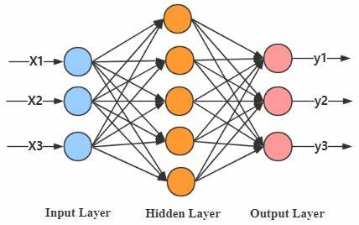
EXISTING SYSTEM
In the existing system there are various methods for predicting the Dissolved oxygen level in aquaculture ponds including ANN.
In the existing system, ANN algorithm was used to predict the rate of dissolved oxygen in water by considering only two or three parameters that effect the rate of Dissolved Oxygen. The dataset considered in the existing system includes a few features of the water in the pond.

Slide 7

DRAWBACKS OF EXISTING MODEL
Hardware Dependence:
Artificial Neural Networks require processors with parallel processing power, by their structure. For this reason, the realization of the equipment is dependent.
Unexplained functioning of the network:
This is the most important problem of ANN.
When ANN gives a probing solution, it does not give a clue as to why and how.
This reduces trust in the network.
Assurance of proper network structure:
There is no specific rule for determining the structure of artificial neural networks.
The appropriate network structure is achieved through experience and trial and
error.
The difficulty of showing the problem to the network:
ANNs can work with numerical information.
Problems have to be translated into numerical values before being introduced
to ANN.ss

Slide 8
PROPOSED SYSTEM
Proposed system uses a Long short term memory (LSTM) along with Gated recurrent Unit(GRU) as a hybrid model for predicting the output.
In the proposed system, the LSTM-GRU algorithm was used
LSTM-GRU is less complex than any other neural network because the gates are flexible.
The Accuracy obtained was almost equal to cent percent which proves using LSTM-GRU gives the best results.
LSTM-GRU trains faster and performs better than any other Artificial neural network.
LSTM-GRU uses less training parameters and therefore uses less memory and executes faster.

Slide 9


Slide 10
MODULES
The major functionalities present in our project are:
Gathering and understanding the data.
Data Visualizing and Data Pre-processing.
Training and Testing the model.
Finding the model that is best fit for the data.

Slide 11
MODULE 1
Module 1 : Gathering and Understanding data
Here, We will gather the data that is suitable to our project and perform Data Analysis.
The data set is collected with different attributes which are used to predict the rate of Dissolved oxygen .
The attributes present in our dataset are Date, Time, Nitrate, PH, Temperature, Dissolved oxygen, Turbidity and Manganese.
And also we analyze the data to ensure Data Integrity.
Some of the libraries used here are Numpy, pandas, keras, matplotlib, Scikit-learn, seaborn.

Slide 12
MODULE 2
Module 2 : Data Visualization and Data Preprocessing
Data visualization is the representation of data or information in a graph, chart, or other visual format. It communicates relationships of the data with images.
Different types of data visualizations present are:
Histogram
Bar plot
Scatter plot
Data pre-processing is a process of cleaning the raw data i.e. the data is collected in the real world and is converted to a clean data set.
It includes outlier detection, filling the missing values and conversion of data

Slide 13
MODULES CONTINUED….
Module 3 : Training and testing the data
Here we measure the accuracy of our model.
The data is divided into two sets: a training set and a testing set where 80% is training and 20% is testing data.
We train the model using the training set and test the model using the testing set.
Module 4 : Fitting the model for data
Our main goal is to train the best performing model possible using the pre-processed data.

Slide 14
PROPOSED ALGORITHM
Algorithm: Prediction of Rate of Dissolved Oxygen in Aquaculture ponds using LSTM-GRU hybrid model .
Input: input all the parameters like ph, turbidity, temperature, …. etc
Output: predict the rate of dissolved oxygen.
Step 1: Loading and Pre-processing of the data
Step 2: Split the data into train data set and test data set
Step 3: Modelling the Training data using LSTM-GRU (Steps 3-5)
Step 4: Initialize the net parameters LSTM net, calculate the forget gate as following.
Ft= σ [(Wf *Xt)+(Wf*h(t-1))+ bf]
Now calculate the output of forget gate as follows:
Ctf= c(t-1)*ft
Step 5: calculate the input gate ,it has two parts as shown below
it= σ [(Wi *Xt)+(Wi*h(t-1))+ bi]
gt=tanh[(Wg*Xt)+(Wg*h(t-1))+ bg]
Now calculate the output of input gate as follows:
Cti= it*gt
Ct=Cti+Ctf.

Slide 15
ALGORITHM CONTINUED…
Step 6 : calculate the output gate ,as below
ot= σ [(Wo *Xt)+(Wo*h(t-1))+ bo]
Step 7 : now calculate :ht = tanh(Ct)+ot.
// GRU algorithm
Step 8 : take the past information as input , Calculate the Update gate Zt As Follows:
Zt= σ [Wz*Xt + Wz* h(t-1)]
Step 9 : Calculate the reset gate denoted by Rt as follows:
Rt= σ [Wr*Xt + Wr* h(t-1)]
Step 10 : Calculate the memory content which will use the reset gate to Store the Relevant information from the past:
ht =tanh[W*Xt+Rt (xnor) W*h(t-1)]
Step 11: Now finally calculate htt—Vector which holds the information, Update gate is Required.
ht=Zt (xnor) h(t-1) +(1- Zt) (xnor) h’t .
Step 12: END.

Slide 16


Slide 17
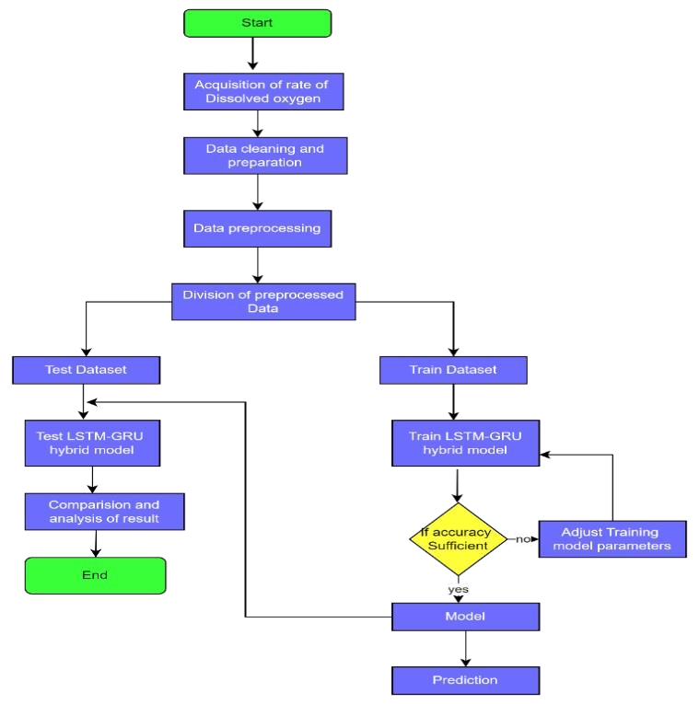

Slide 18
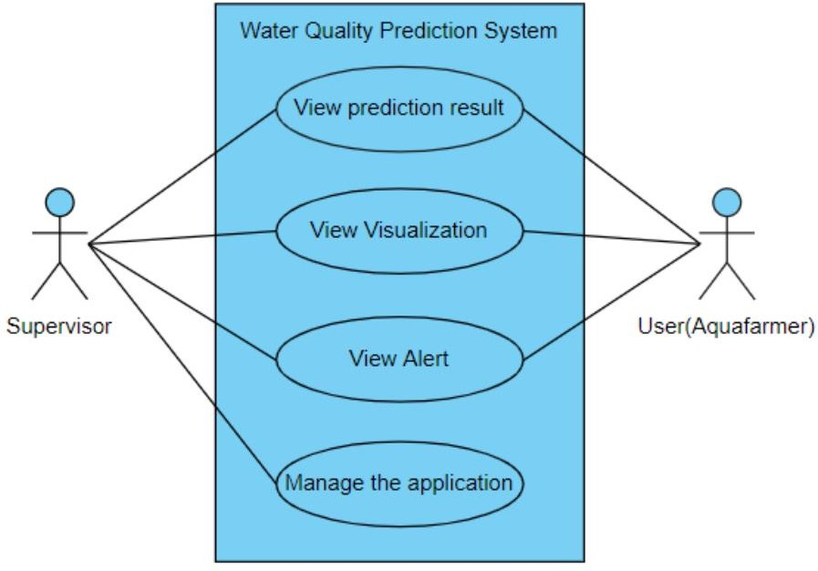
USE CASE DIAGRAM
Dissolved oxygen prediction system

Slide 19
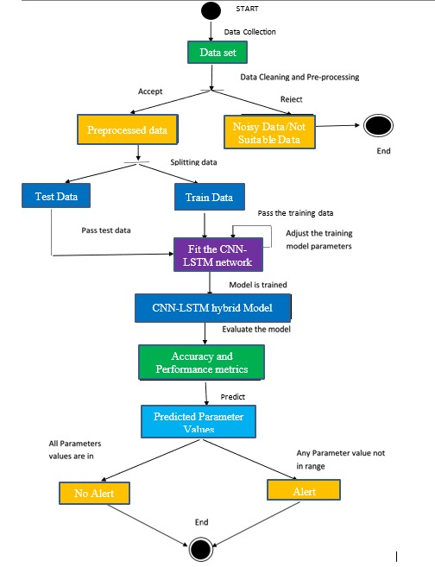
SEQUENCE DIAGRAM
Fit the LSTM-GRU network
LSTM-GRU hybrid model

Slide 20
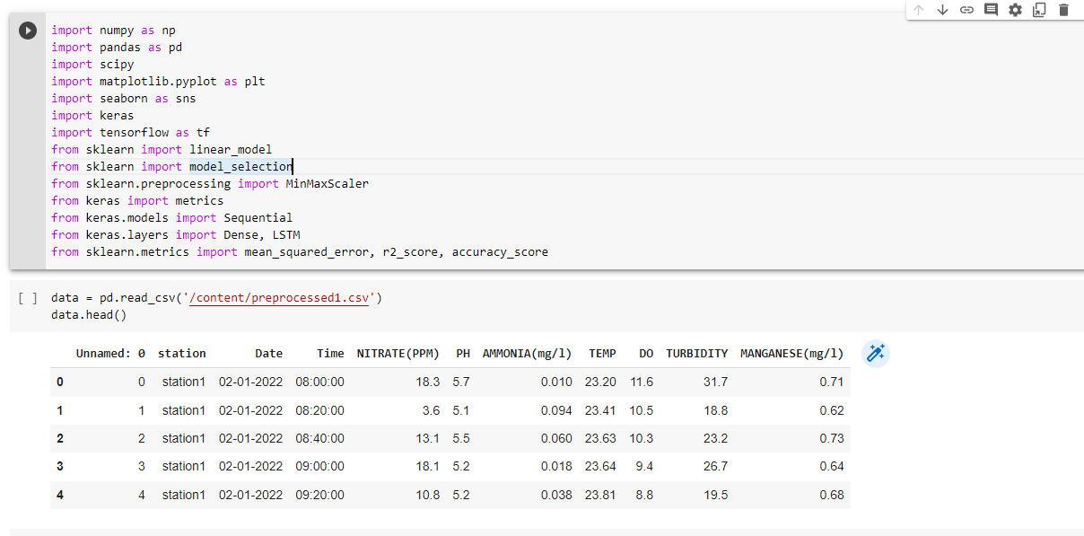
Gathering and understanding the data

Slide 21
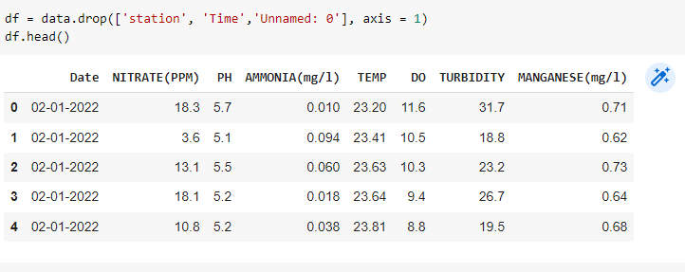
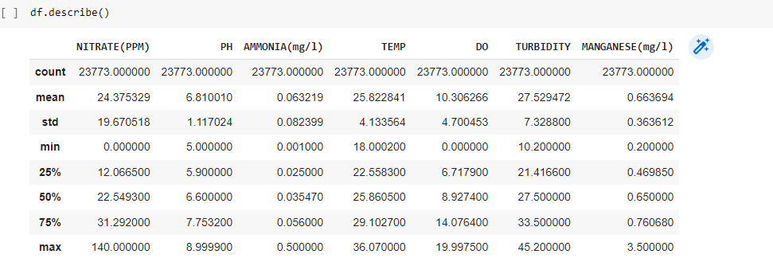

Slide 22
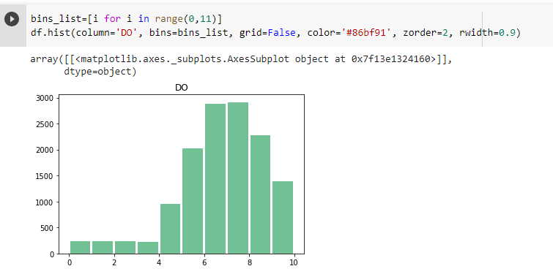
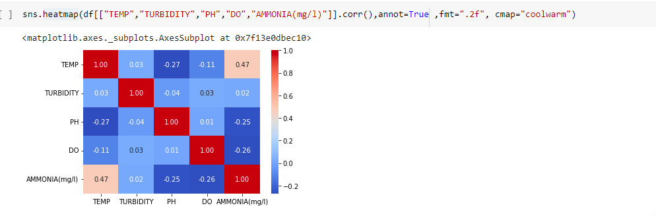
Data Visualization

Slide 23
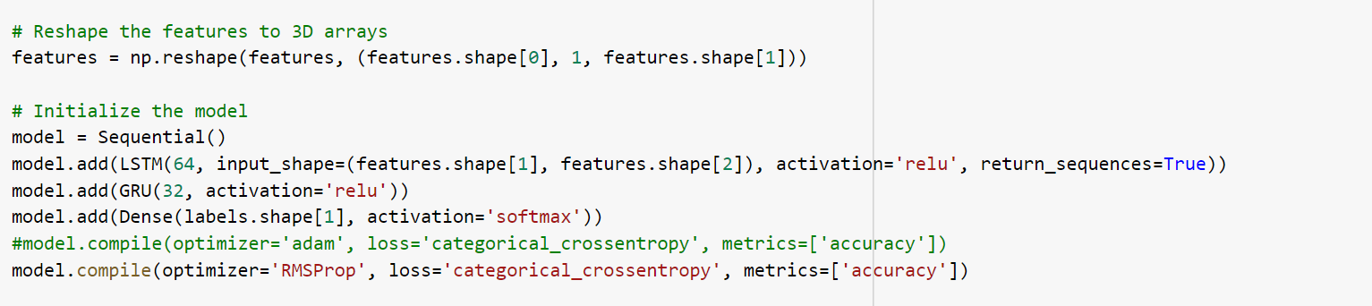
Training and testing the data

Slide 24
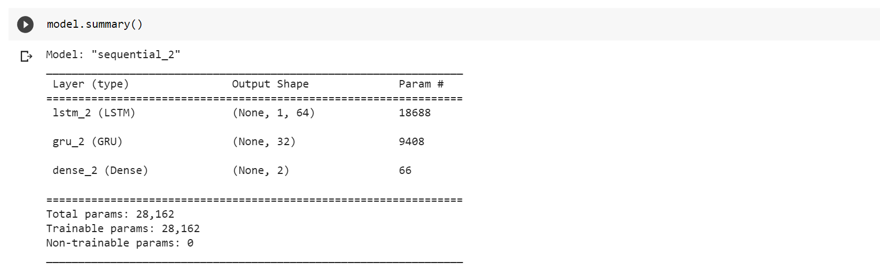
Building the model

Slide 25
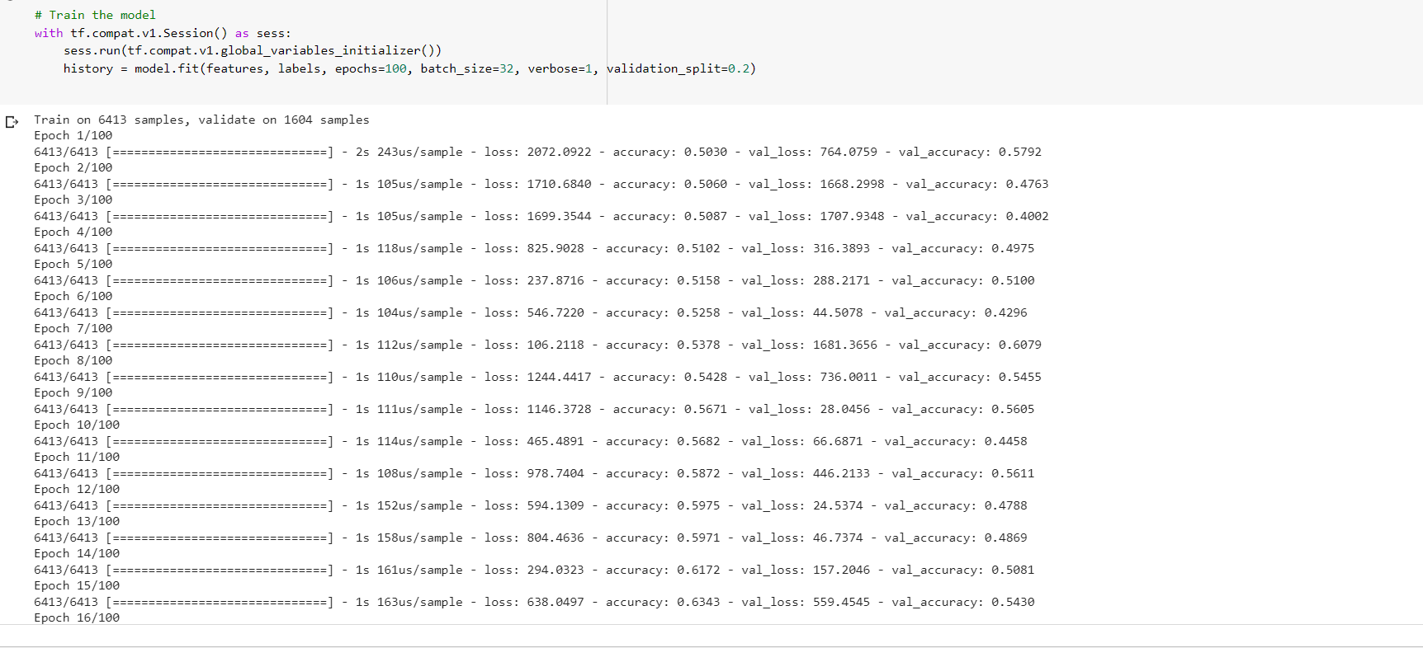
Fitting the model

Slide 26
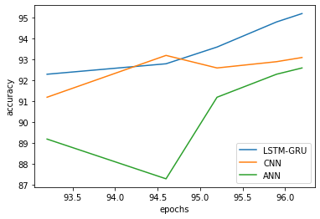
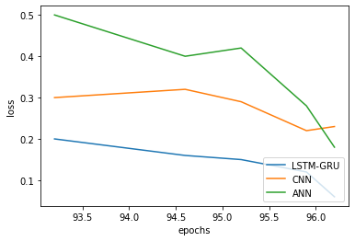
RESULTS
Accuracy
Loss

Slide 27
CONCLUSION
Aquaculture is an extremely important sector of the food and nutrition business. The aim of this hybrid prediction model is to improve aquaculture management by allowing for more precise forecasts of DO concentration. The LSTM method and the GRU approach were combined in order to develop the hybrid model. It is necessary to make accurate real-time predictions of dissolved oxygen levels in order to achieve precise management of recirculating aquaculture. The model that is based on LSTM-GRU has been proposed as a solution to the problems that are caused by traditional prediction models. These models are plagued by insufficient precision and poor stability due to noise in locally observed characteristics of water quality. Its usefulness has been demonstrated through applications in the actual world. It is able to forecast dissolved oxygen levels, hence reducing and minimising needless losses such as the death rate of fish that can be caused by either high or low dissolved oxygen levels. The results of the experimental inquiry show that the LSTM-GRU hybrid model performs better than other models in terms of its overall performance.

Slide 28
REFERENCES
Haq, K. R. A., & Harigovindan, V. P. (2022). Water Quality Prediction for Smart Aquaculture using Hybrid Deep Learning Models. IEEE Access.
Huan, J., Li, H., Li, M., & Chen, B. (2020). Prediction of dissolved oxygen in aquaculture based on gradient boosting decision tree and long short-term memory network: A study of Chang Zhou fishery demonstration base, China. Computers and Electronics in Agriculture, 175, 105530.
Bao, Y. J., Ji, C. Y., & Zhang, B. (2022). Prediction of dissolved oxygen content changes based on two-dimensional behavior features of fish school and T–S fuzzy neural network. Water Science and Engineering.
Yan, J., Liu, J., Yu, Y., & Xu, H. (2021). Water quality prediction in the luan river based on 1-DRCNN and bigru hybrid neural network model. Water, 13(9), 1273.

Slide 29

QUERIES

Slide 30

THANK YOU

